Slide 1
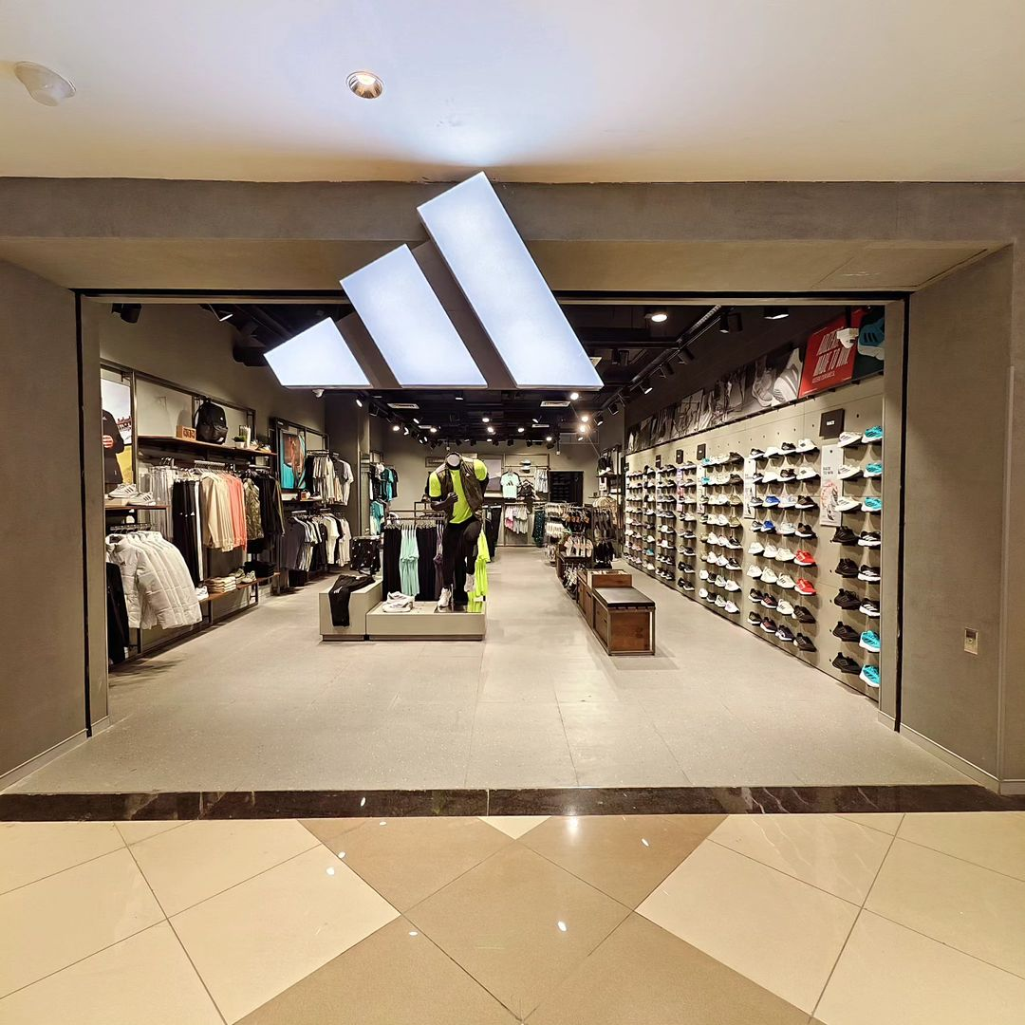
Aggressive Footprint Expansion and Digital Pivot Driving Exponential Growth and Margin Expansion
Adidas US Performance Analysis 2020-2021

Slide 2

Executive Summary
Aggressive Footprint Expansion and Digital Pivot Driving Exponential Growth and Margin Expansion
Performance Verdict
Profitability Lead
Key Drivers
Strategic Implication
Operating Profit (EBITDA proxy) expanded significantly from $63M to $269M, with margins improving by 260 bps to 37.4%.
Growth was primarily fueled by a geographic scale-up (expanding from 8 to 46 states) and the strong performance of the Street Footwear category.
Exceptional Growth. Total Revenue surged by 294% YoY, reaching $718M in 2021, driven by a massive 336% increase in unit volume.
The Online channel is the most profitable lever; leadership should prioritize "Digital-First" retail to sustain margin expansion during the next phase of maturity.

Slide 3
Market & Revenue Performance Analysis
Adidas US Revenue Surged 294% YoY, Powered by Massive Volume Expansion and Geographic Reach
YoY Momentum
Volume vs. Price
Total Sales jumped from $182.1M (2020) to $717.8M (2021).
Growth is entirely volume-driven (Units Sold: +336%). Average Price per Unit saw a slight compression (from $394 to $356), likely due to increased promotional activity or a shift toward high-volume outlet channels.
Regional Footprint
Product Dominance
The West Region is the primary engine of growth, contributing 26.9% of total 2021 revenue.
Street Footwear remains the flagship category, generating the highest total sales volume ($268M+ in 2021).

Slide 4

Profitability Analysis
EBITDA Margins Expanded to 37.4% Supported by Favorable Channel Mix and Operational Leverage
EBITDA Growth
Channel Profitability
Total EBITDA (Operating Profit) grew 324% YoY, outstripping revenue growth and indicating strong operational leverage.
Online is the highest-margin channel (38.8%), followed closely by Outlets. While In-store generates significant volume, its higher overhead profile results in lower relative margins (36.5%).
Margin Benchmark
2020 Margin: 34.8%
2021 Margin: 37.4% (+2.6% Improvement)
Driver of Expansion
The shift toward digital and outlet-based liquidation of high-volume units has optimized the bottom line despite a lower average unit price.

Slide 5

Operational Efficiency Analysis
Robust Scale-Up Efficiency Despite Unit Price Compression
Revenue per Unit
Productivity Improvement
Efficiency-Profit Link
Bottlenecks
Declined by ~10% YoY. This suggests a strategic pivot toward market share acquisition over premium pricing during the 2021 expansion.
In-store sales remain the most "expensive" way to sell; further expansion should be balanced against the lower capital expenditure (CapEx) requirements of digital channels.
Despite the price drop, the EBITDA per unit remains healthy due to the efficiency of the Online channel and bulk sales through major retailers like Foot Locker and West Gear.
Higher volume allowed for better fixed-cost absorption, contributing to the 2.6% margin expansion even as per-unit revenue dipped.

Slide 6

Key Insights & Root Causes
Geographic Expansion is the Primary Growth Engine, While Street Footwear Validates Lifestyle Brand Pivot
Symptom
Root Cause
Consulting Logic (MECE)
Massive Sales Spike
Footprint Expansion
The increase is not purely organic; the company scaled from 8 states in 2020 to 46 in 2021.
Margin Improvement
Digital Efficiency
Increased reliance on Online channels reduced the physical footprint cost per dollar of revenue.
Price Compression
Channel & Product Mix
High growth in "Outlets" and "Apparel" (lower price point) diluted the premium footwear average.
Regional Concentration
West Coast Dominance
Strategic partnership with West Gear and Foot Locker in key urban hubs (CA, NY, FL).

Slide 7

Strategic Recommendations
Transition from "Expansion Mode" to "Margin Optimization" to Sustain Long-Term Value
01
02
03
Double-Down on Digital-First (Direct-to-Consumer)
Premiumize the "Street Footwear" Segment
Optimize Underperforming Regions
Rationale: Online channels offer the highest margins (38.8%).
Impact: High EBITDA Growth.
Rationale: Leverage the high volume of Street Footwear to introduce high-margin, limited-edition collaborations.
Impact: High Revenue & Margin.
Rationale: The South and Midwest regions show lower market penetration compared to the West.
Impact: Medium Revenue Growth.

Slide 8

Risks & Next Steps
Data Limitations and Macroeconomic Volatility Require Close Monitoring
Key Risks
Low-Base Effect: The 2020 data is significantly smaller in scope (8 states), making YoY percentages look abnormally high.
Inventory Costs: Rapid expansion in 2021 might lead to inventory bloat if demand softens in 2022.
Data Limitations
Lack of marketing spend data (CAC) prevents a full "Net Profit" analysis.
Customer retention and repeat-purchase data is missing.

